Slide 1

Nomological Networks
Nomological Networks

Slide 2
Nomological Networks
Laws in the nomological network may relate:
Observable quantities together
Theoretical constructs to observables
Theoretical constructs to one another
For a construct to be scientifically admissible it must (directly or indirectly) involve observables
Learning more about a construct means expanding the nomological network
Cronbach & Meehl (1954)

Slide 3
Nomological Networks
Unless the network makes contact with observations, and exhibits explicit, public steps of inference, construct validation cannot be claimed (p12)
Cronbach & Meehl (1954)

Slide 4


Nomological Networks
Does the measure refer to underlying theoretical concepts?
Is there a well-developed theoretical and conceptual understanding of the construct/dimension being measured?
Air
Fuel
Heat
Fire
Smoke
Cooking
Water
Light
Made of diamonds?

Slide 5
Nomological Networks
Measure X
Sweaty Palms
Academic aspiration
Anxiety Proneness
r = 0.5
Threat of pain
Failed Exam

Slide 6
Nomological Networks
Observed tenseness
Measure X
Sweaty Palms
r = 0.45
r = 0.5
Intellectual inefficiency from electric shock
r = 0.55
r = 0.68
Failed Exam
Anxiety scale

Slide 7
Nomological Networks
Social class
Measure X
Sweaty Palms
Anxiety Proneness
r = 0.01
r = 0.5
Vocational aim
r = -0.009
r = 0.003
Failed Exam
Value orientation

Slide 8
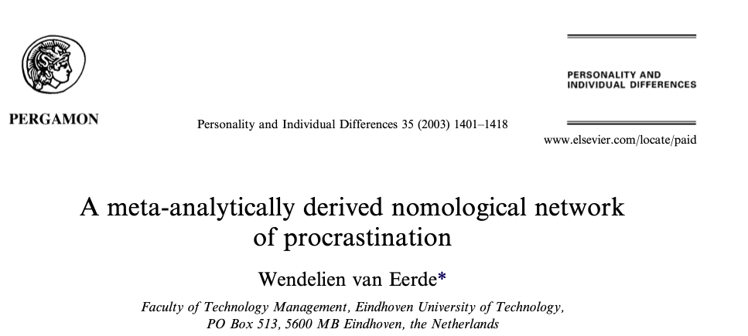
Nomological Networks
Demographics & cognitive ability
Personality variables:
Conscientiousness
Neuroticism
Trait anxiety
Pessimism
Self image
Self Efficacy
Self esteem
Motives
Fear of failure
Perfectionism
‘self handicapping’
Affect
State anxiety
Depression
Performance
Missed deadlines
Time spent preparing
Time spent performing
Grades
GPA
To what extent can we claim that Procrastination exists?
Theoretical Constructs
Meta-analysis:
A statistical analysis that is
run on the results of
a set of studies
Observable

Slide 9
Nomological Networks
Conscientiousness
-0.67
Other research also suggests
this strength of connection
Procrastination
Neuroticism
Trait Anxiety
0.26
0.24

Slide 10
Nomological Networks
Grade point average
-0.28
Procrastination
Task Completion Time
0.06
0.46
0.35
“Self-Handicapping”
Task Delay

Slide 11
Nomological Networks
Conscientiousness
Trait Anxiety
-0.67
0.24
Neuroticism
0.26
Procrastination
0.06
Task Completion Time
-0.28
Fear of failure
0.46
0.35
Grade point average
“Self-Handicapping”
Depression
Task Delay
Missed deadlines

